Slide 1

Visual Product Recognition Challenge (Image-Based Product Search)
Group 16:
1. PAIRAVI . T (200441F)
2. PATHIRANA A.S.W (200448H)
3. PATHIRAJE P.M.H.K (200447E)

Slide 2

Content
Problem Description
Data Collection
Data Preparation
Insights through data analysis
Approach
MVP
Future Developments
Conclusion

Slide 3
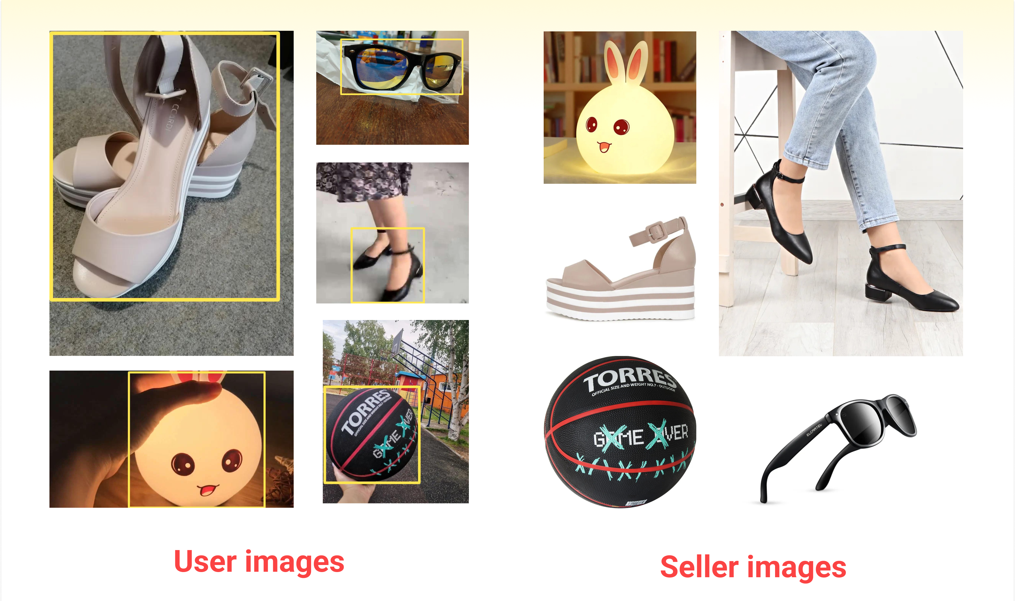
Problem Description
Problem Statement:
The ability to search efficiently and accurately among millions of items on e-commerce platforms is a critical feature. Unless users know the exact product names, traditional text-based search engines may fall short. Image-based search has emerged as a promising solution to this problem, particularly in scenarios where customers encounter products in real life, movies, or online media. This challenge aims to push existing computer vision methods to their limits in the context of image-based product search.
Problem:
The problem is categorizing product images into user and seller photos. User photos are frequently taken on mobile phones in cluttered settings, whereas seller photos are
professionally shot images used for online marketplaces. To highlight the
products in user photos, bounding boxes are provided. These images
and bounding boxes function as search terms. The main goal is to create
an algorithm that can accurately identify matching product images from
the seller photo gallery given a search query (user image with bounding
box).

Slide 4
Data Collection
Data Sources:
Development test set provided by the challenge organizers.
● Description: The development test set includes two key files, "gallery.csv" and "queries.csv”. "gallery.csv" contains product images as well as identifiers and file paths, whereas "queries.csv" contains user images as well as bounding box coordinates and corresponding identifiers.
For this competition, they did not explicitly provide a training dataset. Participants are instead encouraged to use publicly available data under common-use licenses or other research datasets such as "Products10K" for training.
Training set (Product10K) from Kaggle.
● Description: The training set, "Products10K," is a publicly available dataset from Kaggle that contains a large number of product images from various categories, angles, and visual conditions. Each product has its own set of metadata, which aids in categorization and classification.

Slide 5
Data Preparation
Data Gathering : "products-10k" images are grouped by class labels, and samples from each class are collected for training. Classes with a sufficient number of samples are chosen.
Class Balancing: Ensured that each class had enough samples for training.
Data Preparation: Prepared data samples and labels for training.
Data Augmentation : ImageNet-style augmentation, Happy Whale augmentation , Cut-Out
Image Transformation : Images are then resized and normalized using mean and standard deviation values and transformed to a common size (e.g. 224x224).
Data Loader Creation : It includes the following steps: data loading and preprocessing, final transformations, and augmentation options.
We formed training data loaders using defined transformations and PyTorch's Data Loader.
Validation Loader : We created a validation loader, mirroring training loader but for validation purposes.

Slide 6
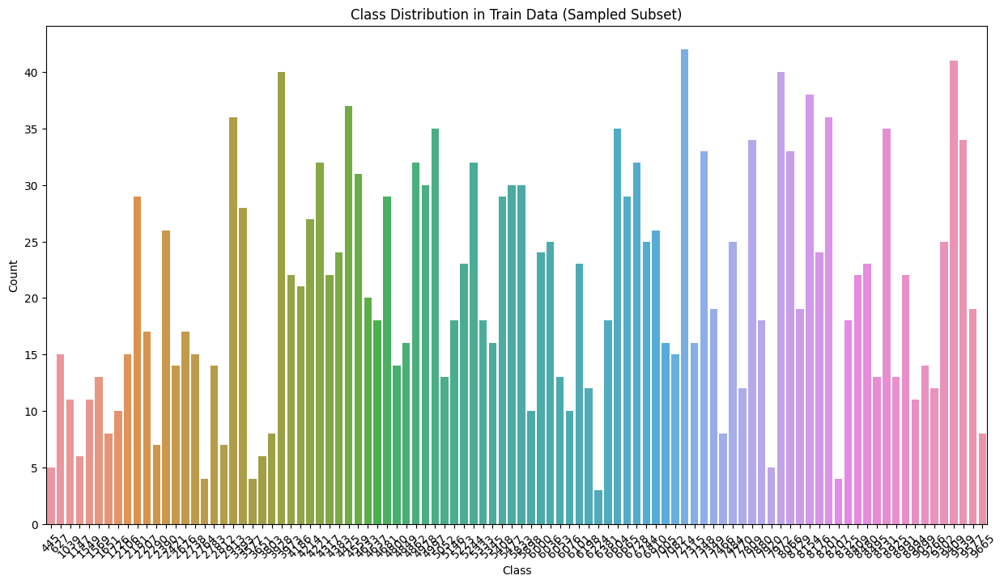
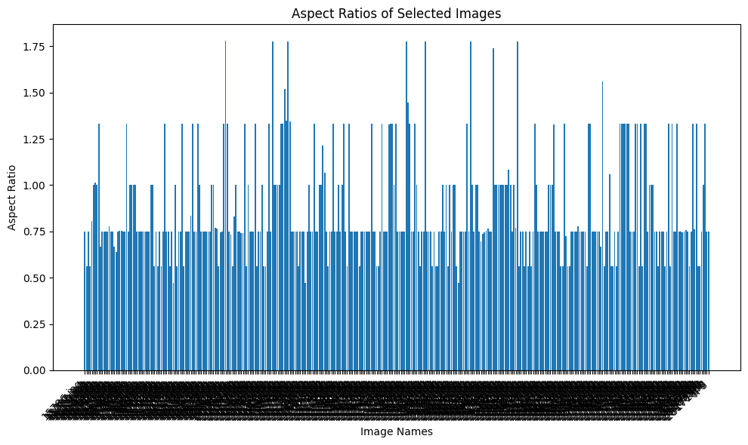
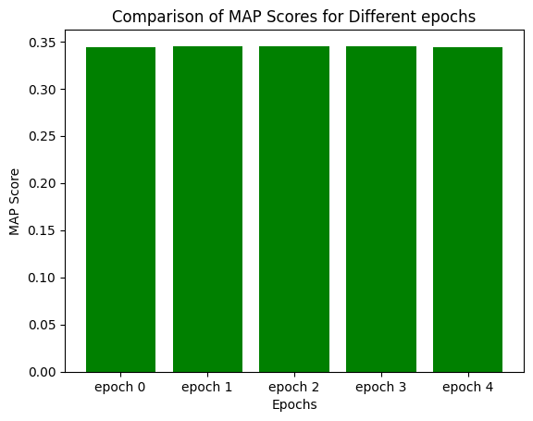

Slide 7
Approach
Model Building : We used ViT backbone(ViT-H-14 and ViT-B-16) to extract meaningful features from the images. Extracted features from the ViT backbone are sent through the custom head for additional processing, and the resulting features are likely to be used for accomplishing similarity product search using OpenAI's CLIP model.
Training and Validation : The model was trained using the prepared data and augmented images. For more stable training, gradient scaling and accumulation were implemented. For optimization, we used learning rate scheduling. To calculate validation scores, the model was evaluated on gallery and query datasets. To avoid overfitting, early stopping was implemented.
Data Loader Development : Custom data loaders were developed for the efficient loading, transformation, and batching of training and validation data. To manage data during training, We used PyTorch's DataLoader class.
Experimentation and Evaluation : Multiple experiments were carried out with various data augmentation and model head variations. Validation scores were tracked in order to assess model performance. Models were saved at various epochs to aid in model selection.

Slide 8
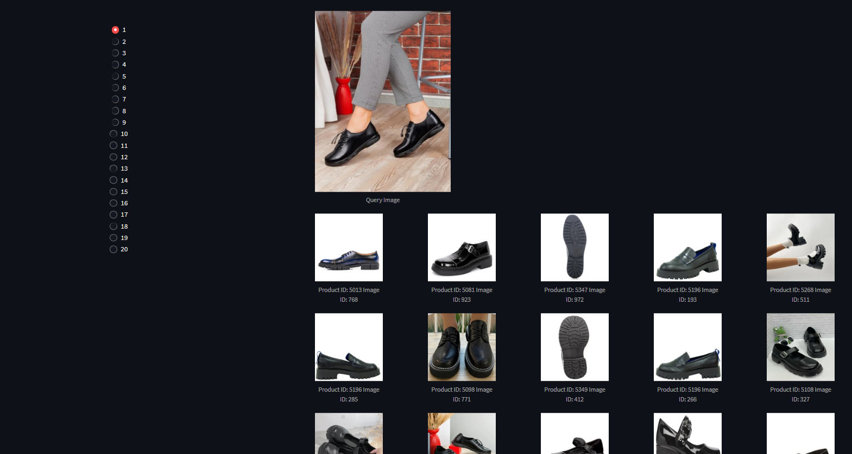

Slide 9
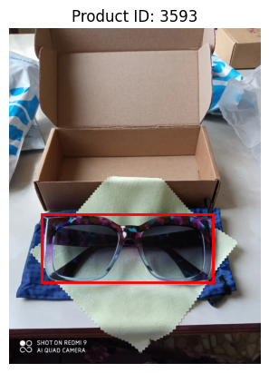
Future Developments
Investigate advanced architectures and pre-trained models, such as transformer-based models.
Experiment with various fine-tuning strategies like differential learning rates.
Improve ensemble techniques by experimenting with different model combinations.
Research and implement more sophisticated data augmentation techniques, such as generative adversarial networks (GANs)
Create an easy-to-use interface that allows users to upload images and draw bounding boxes around the products they want to search for.
We planned to choose object detection model, YOLO , that can identify objects and draw bounding boxes around them in an image.
Set up a backend server using Flask to receive image uploads and bounding box coordinates from the user interface.
Investigate techniques to enable real-time processing

Slide 10





Conclusion
Name
For a revolutionary product search experience, our MVP employs vision transformers and data augmentation.
The foundation is the CLIP-ViT-H/14 and ViT-B-16 models, with custom heads and ArcFace loss for feature embedding and classification.
Future developments include improving the existing model and ensembling models with different augmentation techniques , drawing a boundary box within an image, and detecting objects.

Slide 11

Thank you!

